Slide 1

time-series prediction model to forecast future COVID-19
COVID-19 Case Prediction

Slide 2

Problem statement:
The COVID-19 pandemic has caused immense global health and economic challenges. Timely and accurate forecasting of COVID-19 case trends is essential for effective resource allocation, healthcare planning, and public policy decisions. However, the dynamic and rapidly evolving nature of the pandemic makes prediction difficult.
This project aims to develop a time-series prediction model that utilizes historical COVID-19 case data to forecast future infection trends. By applying regression techniques and visualizing the evolving patterns of the virus spread, the model seeks to provide reliable short-term and long-term forecasts. These forecasts can help authorities and the general public as well as government better understand the trajectory of the outbreak and make data-driven decisions

Slide 3
Dataset Description: COVID-19 Data from Johns Hopkins University
Temporal Scope: Daily reports from January 22, 2020, to the most recent available date.
Geographic Coverage: Worldwide — includes data for individual countries, states/provinces, and some cities.
Data Granularity:
Country-level
Province/state-level
.Date wise data: Each row corresponds to a location (e.g., a country or state).
Key Files and Their Contents:
1. time_series_covid19_confirmed_global.csv
Cumulative confirmed cases by country/region.
2. time_series_covid19_deaths_global.csv
Cumulative death counts from COVID-19.

Slide 4
Model Training:
Model Training (Polynomial Regression)
The model uses Polynomial Regression to capture non-linear trends in the data of COVID 19 confirmed cases and death cases.
First, the date feature is converted to ordinal numbers (1,2,etc).
Then, these numbers are transformed into polynomial features (e.g., x,x2x, x^2x,x2) using Polynomial Features.
After transformation, a Linear Regression model is trained on these new features.
This allows the model to fit curved patterns in the data while still using linear methods behind the scenes.

Slide 5
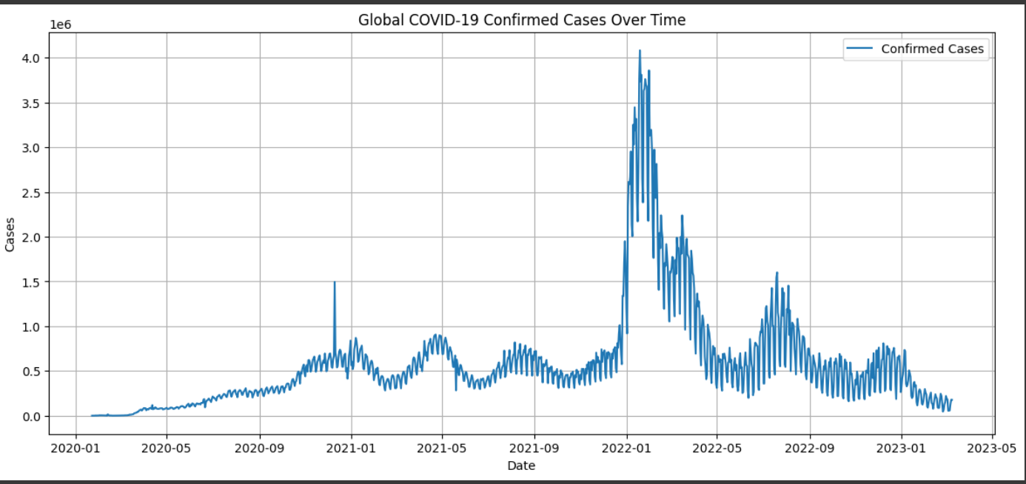
Result and trends(confirmed cases):

Slide 6
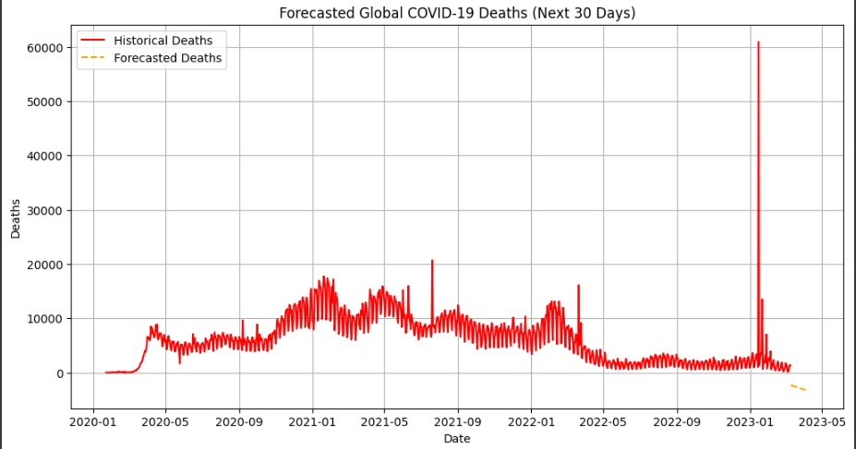
Result and trends analysis(Death cases):

Slide 7
Conclusion:
Conclusion
The COVID-19 dataset from Johns Hopkins University provides a comprehensive and reliable source of global pandemic data, including daily counts of confirmed cases, deaths, and recoveries. With detailed geographic information and time-series structure, it enables effective analysis of the virus's spread and impact over time. This dataset is essential for building predictive models, identifying trends, and supporting informed public health decisions.

Slide 8
Teammates and their work distribution:
Amit Kumar: Report making.
Amit Kumar: Done the coding.
Ananya Bharti: Power point Presentation.
Anushka Jaiswal: Coding.
Akshat Saxena: Explaining and understanding of Code.

Slide 9
Thanking You!
Team Number : 02

